Slide 1

ANALYSIS OF MEDICAL COST INSURANCE USING DIFFERENT
REGRESSION MODELS
Submitted by:
Aakashdeep Bhardwaj C0861117
Jaspreet Kaur C0861116
Karnav Patel C0860062
Shreya Manral C0855246

Slide 2
Abstract
Goal of the model is to predict accurately the insurance costs.
Build different regression models for Medical insurance cost dataset.
The dataset consists of age, sex, BMI(body mass index), children, smoker and region feature, which are independent and charge as a dependent feature.
We will use different method to calculate the error.
For Visualizations and to represent data in readable form we will be using tools like pandas, matplotlib, seaborn

Slide 3
Background
What is Machine Learning?
Supervised and Unsupervised Machine Learning Problems
What is a Regression Model? Why do we use it?

Slide 4
Dataset
This dataset has 6 variable:
Age: age of primary beneficiary.
Sex: insurance contractor gender, female, male.
BMI: Body mass index, providing an understanding of body, weights that are relatively high or low relative to height, objective index of body weight (kg/m^2) using the ratio of height to weight, ideally 18.5 to 24.9.
Children: Number of children covered by health insurance/Number of dependents.
Smoker: Is the person a smoker or not.
Region: the beneficiary's residential area in the US, northeast, southeast, southwest, northwest.
Charges: Individual medical costs billed by health insurance

Slide 5
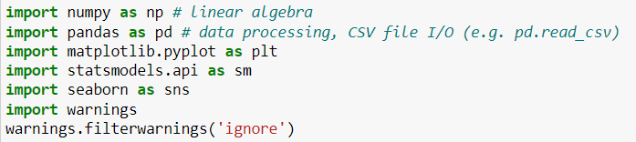

Importing Libraries
Uploading dataset

Slide 6
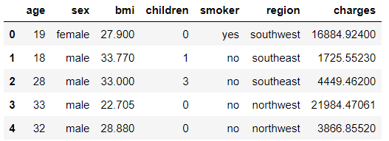

Rows and columns

Slide 7
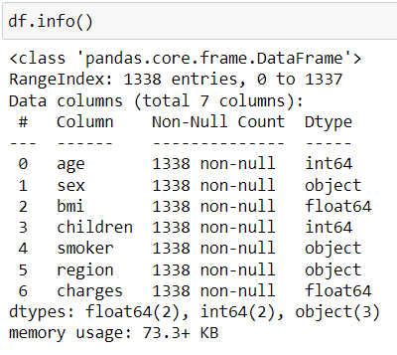
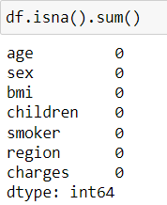
Dataset details : attributes of our dataset and which attribute we are selecting as an independent variable
Dataset Summary : check missing values, whether data types are correct, number of rows and columns

Slide 8

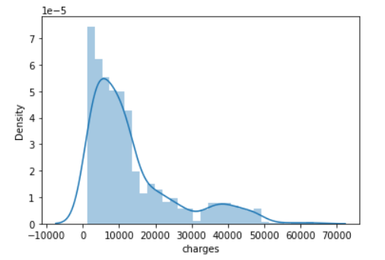
Analysis of Target Variable

Slide 9

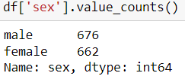
Columns in our Dataset
To find number of quantity in each category

Slide 10
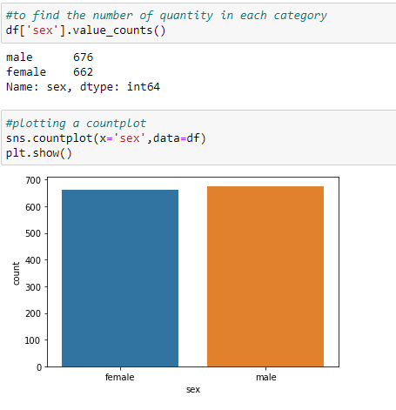
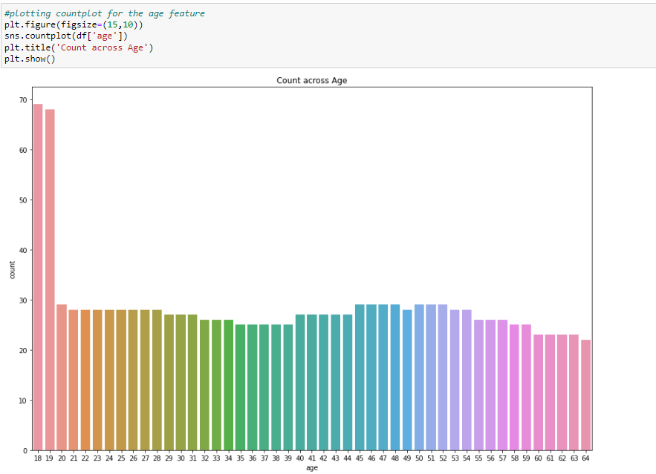
Univariate Analysis

Slide 11
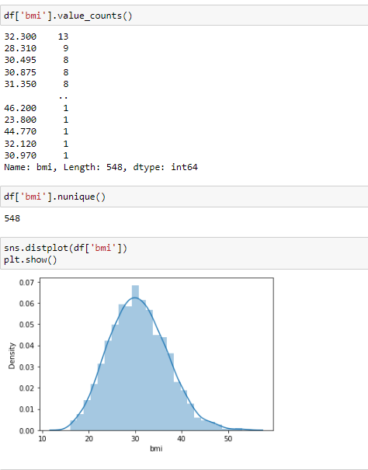
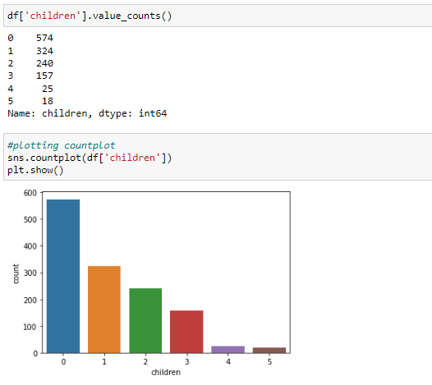
Univariate Analysis

Slide 12
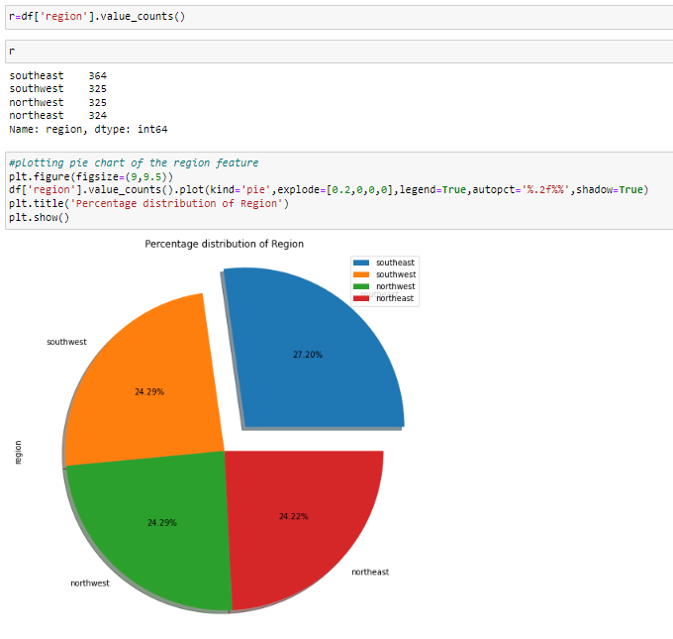
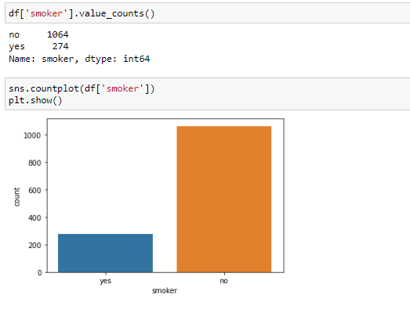
Univariate Analysis

Slide 13
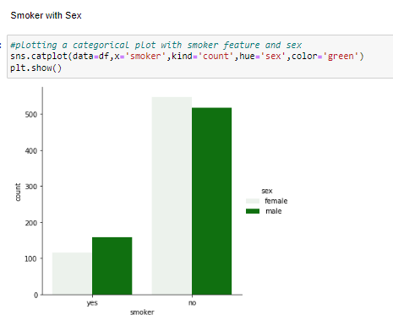
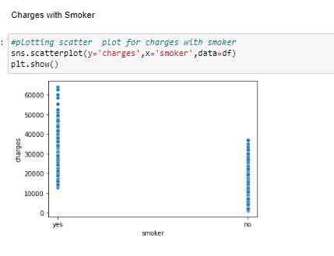
Bivariate Analysis

Slide 14
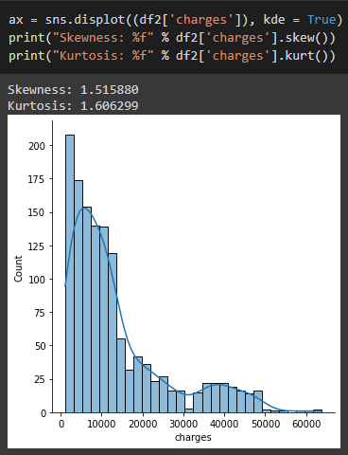
Skewness and Kurtosis
Skewness is a measure of the asymmetry of a distribution.
Kurtosis is a statistical measure that defines how heavily the tails of a distribution differ from the tails of a normal distribution

Slide 15
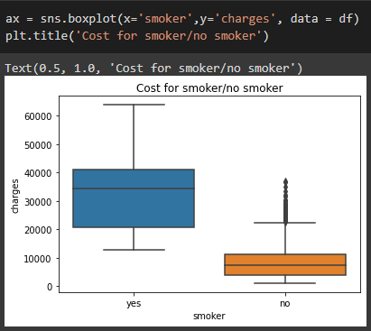
Box Plot

Slide 16
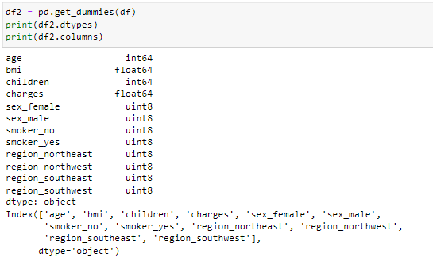
Feature Engineering - One Hot Encoding
One hot encoding is the most widespread approach, and it works very well unless your categorical variable takes on a large number of values
One hot encoding creates new (binary) columns, indicating the presence of each possible value from the original data.

Slide 17

Feature Creation
Creating features involves identifying the variables that will be most useful in the predictive model.
To develop new, more powerful derived features, existing features are combined through addition, subtraction, multiplication, and ratio.

Slide 18
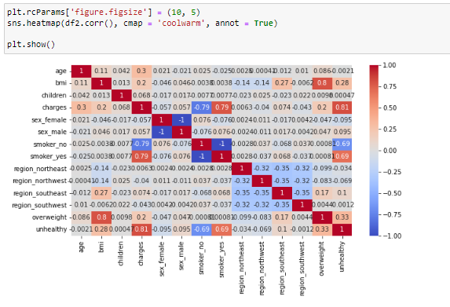
Heatmap

Slide 19
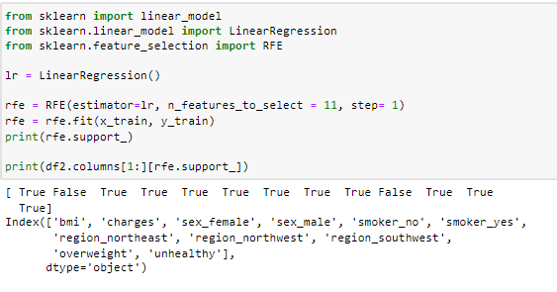

Recursive Feature Elimination
The features ‘age’ and ‘region_southeast’ have been eliminated.

Slide 20

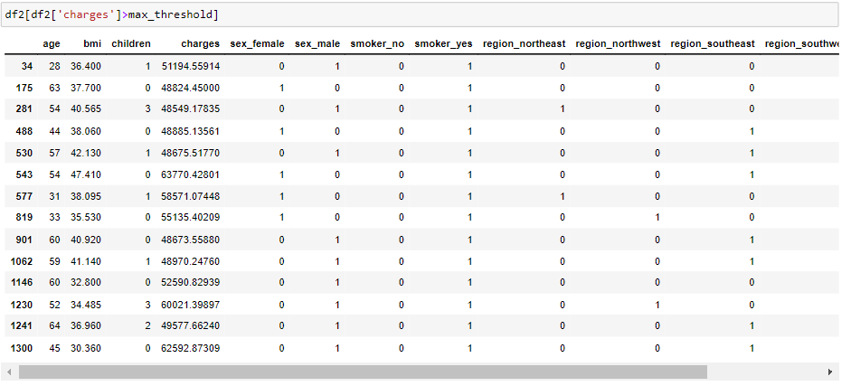
Outlier Handling
Max threshold has been defined as the percentile 99 of the charges.

Slide 21

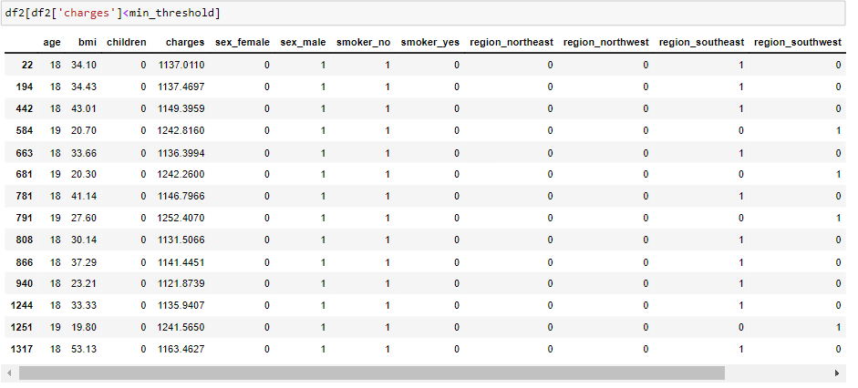
Minimum threshold for charges has been defined as percentile 1.

Slide 22
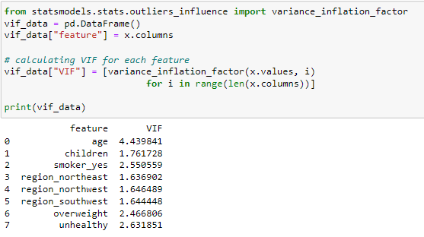
Visualizing the Multicollinearity
1 = not correlated
Between 1 and 5 = moderately correlated
Greater than 5 = Highly correlated

Slide 23
Data Modelling
We will be using different types of Machine Learning Algorithms , i.e. Random Forest Regressor , Gradient Boosting and XGBoost
We will discuss which model gave the best result.

Slide 24
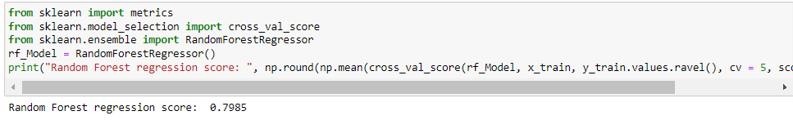
Training the Random Forest Regressor
A random forest is a meta estimator that fits a number of classifying decision trees on various sub-samples of the dataset and uses averaging to improve the predictive accuracy and control over-fitting. The final output of the model is the average of outputs of all decision trees.

Slide 25
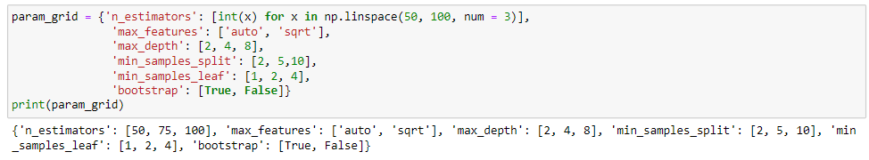
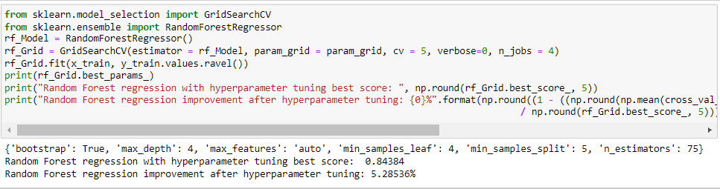
Hyperparameter Tuning for Random Forest Regressor

Slide 26
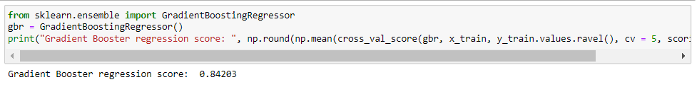
Gradient Boosting Regressor
A Gradient Boosting algorithm is built iteratively by combining prediction from several weak learners. In each iteration step higher emphasis (or weight) is given to those data points which were wrongly predicted in the previous steps.

Slide 27
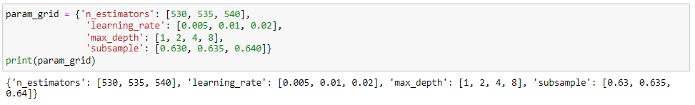
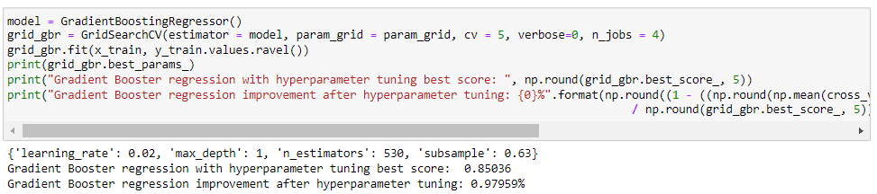
Hyperparameter Tuning for Gradient Boosting Regressor

Slide 28
XGBoost Regressor
XGBoost (eXtreme Gradient Boosting) is not only an algorithm. It’s an entire open-source library, designed as an optimized implementation of the Gradient Boosting framework. It focuses on speed, flexibility, and model performances.

Slide 29
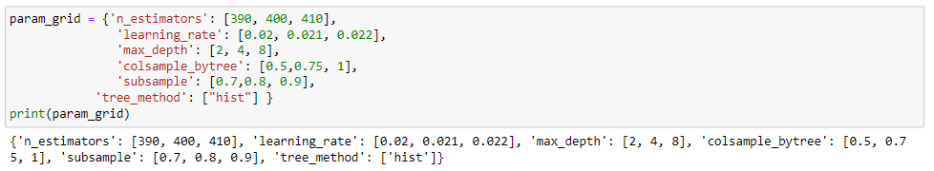
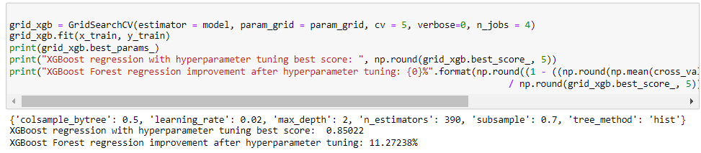
Hyperparameter Tuning for XGBoost Regressor

Slide 30
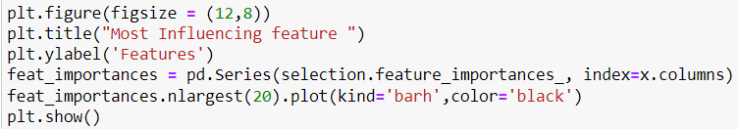
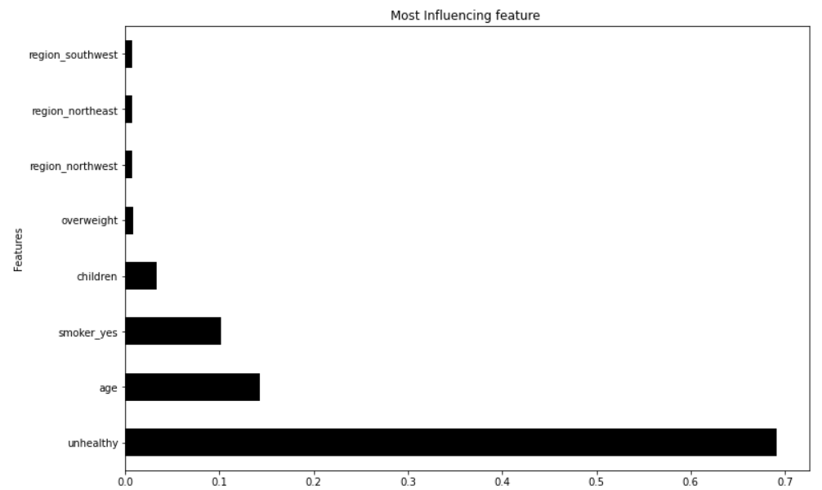
Identifying Most Influencing Feature

Slide 31
Conclusion
In order to differentiate which model was the best, since all of them have an R2 of 0.9, We decided to use mean squared error as the metric to differentiate them and Gradient Boosting regression model was the winner.
Most influencing feature which affect the insurance charges is “Unhealthy” which is derived from “smoker_yes” and “overweight”.
The benefit can administered by a central organization such as a government agency, private business,or not-for-profit entity by utilizing such models.

Slide 32
Future Work
We can try to use more regression models and compare the results.
We can also built an Artificial neural network and later on improve our ANN accuracy based on the results we get.

Slide 33
References
https://towardsdatascience.com/hyperparameter-tuning-the-random-forest-in-python-using-scikit-learn-28d2aa77dd74
https://towardsdatascience.com/hyperparameter-optimization-in-gradient-boosting-packages-with-bayesian-optimization-aaf1b27e7b90
https://towardsdatascience.com/xgboost-fine-tune-and-optimize-your-model-23d996fab663
https://www.spcforexcel.com
https://www.scribbr.com/statistics/skewness/
https://www.investopedia.com/terms/v/variance-inflation-factor.asp#:~:text=Variance%20inflation%20factor%20(VIF)%20is,only%20that%20single%20independent%20variable
https://towardsdatascience.com/what-is-feature-engineering-importance-tools-and-techniques-for-machine-learning-2080b0269f10#:~:text=Feature%20engineering%20is%20a%20machine,while%20also%20enhancing%20model%20accuracy

Slide 34
Thank You

